Slide 1
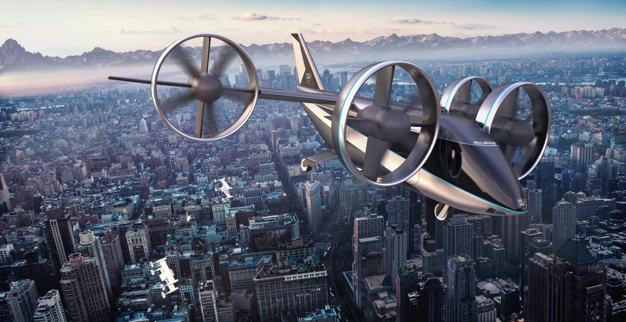
Propulsion Systems for e-VTOL aircraft
Sam Drury
17/03/2021
Supervisor:
Dr Sam Grimshaw
Whittle Laboratory

Slide 2
Progress
Loss Model
CFD
Optimiser
Guestimating current eVTOLs
Not sure really what to present – exploring cfd

Slide 3
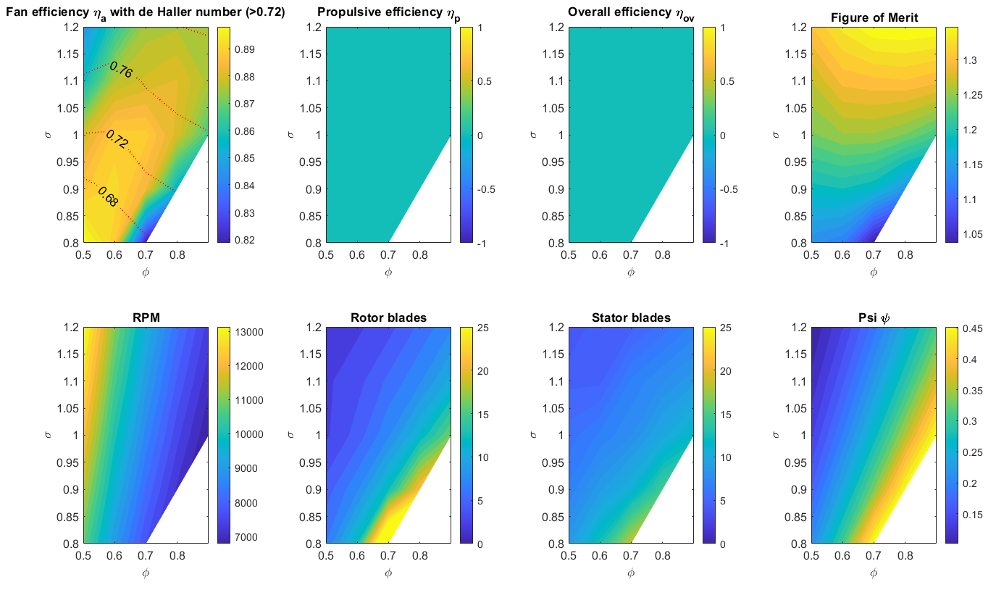
NRF Designs (small geometry)
Low minimum de Haller number (V2/V1) at high aero efficiency

Slide 4
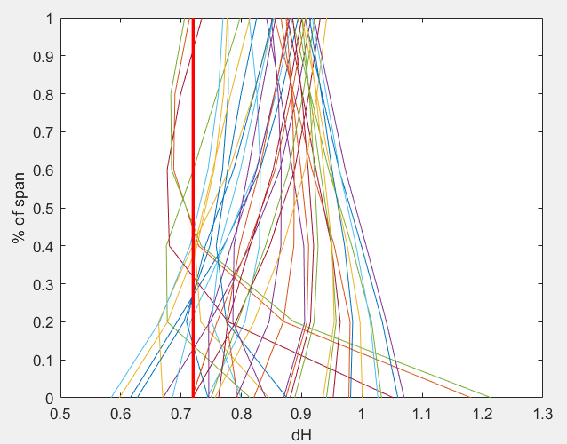
Spanwise variation of de Haller number
Typical rotor
Typical stator
Rotor hub issues
Suggested minimum dH = 0.72

Slide 5
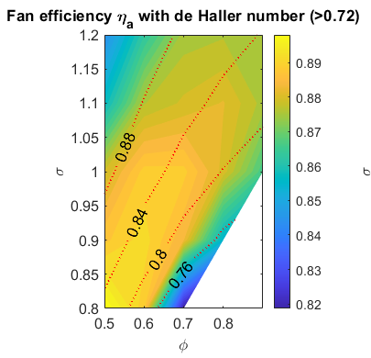
dH comparison – mean line vs minimum
Minimum
Mean line

Slide 6
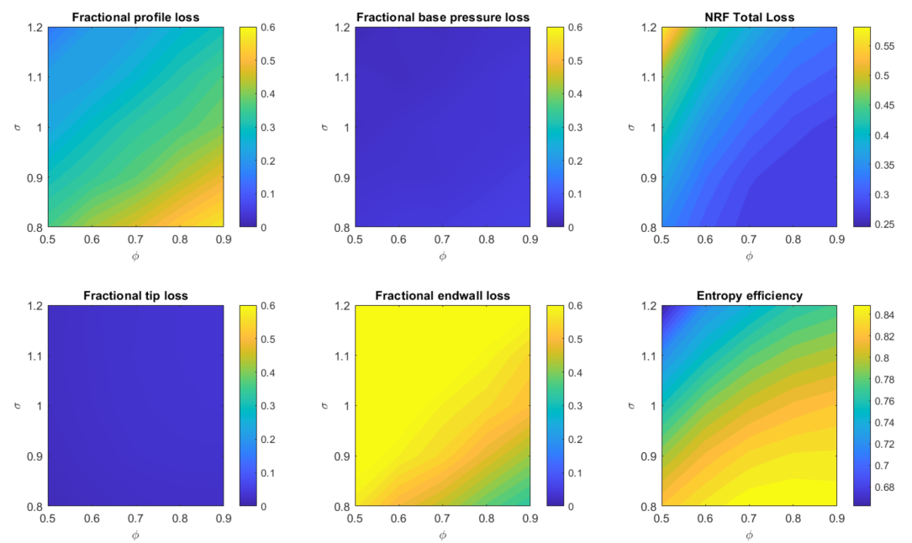
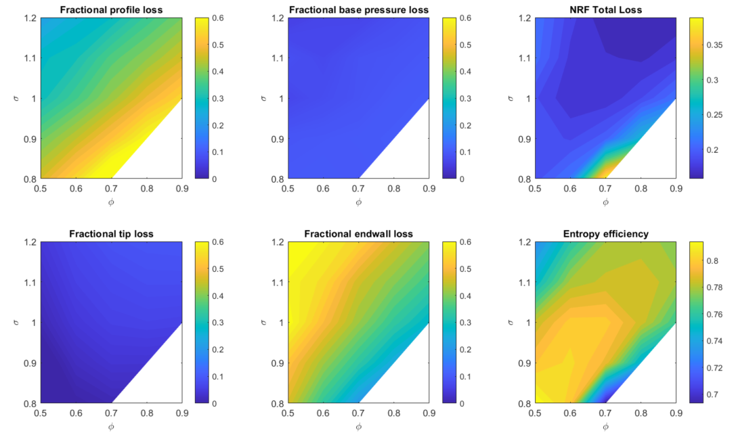
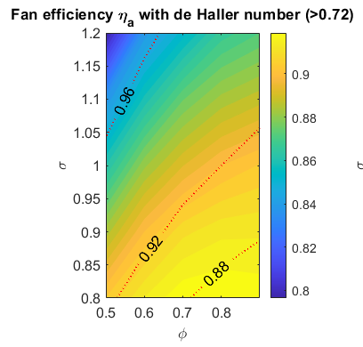
Loss Origin Comparison - varying geometry
Large geometry (Blue Bear)
Small geometry
Endwall contribution increases with size
Smith chart alters
Notes:
Not the same as my last conclusions!
Cd was factor of 10 lower to prevent blowing up – improvements in stability helped this

Slide 7
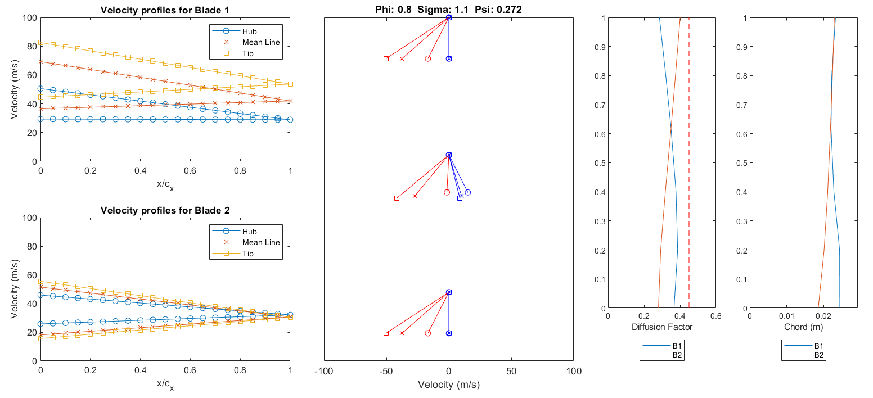
Design point NRF

Slide 8
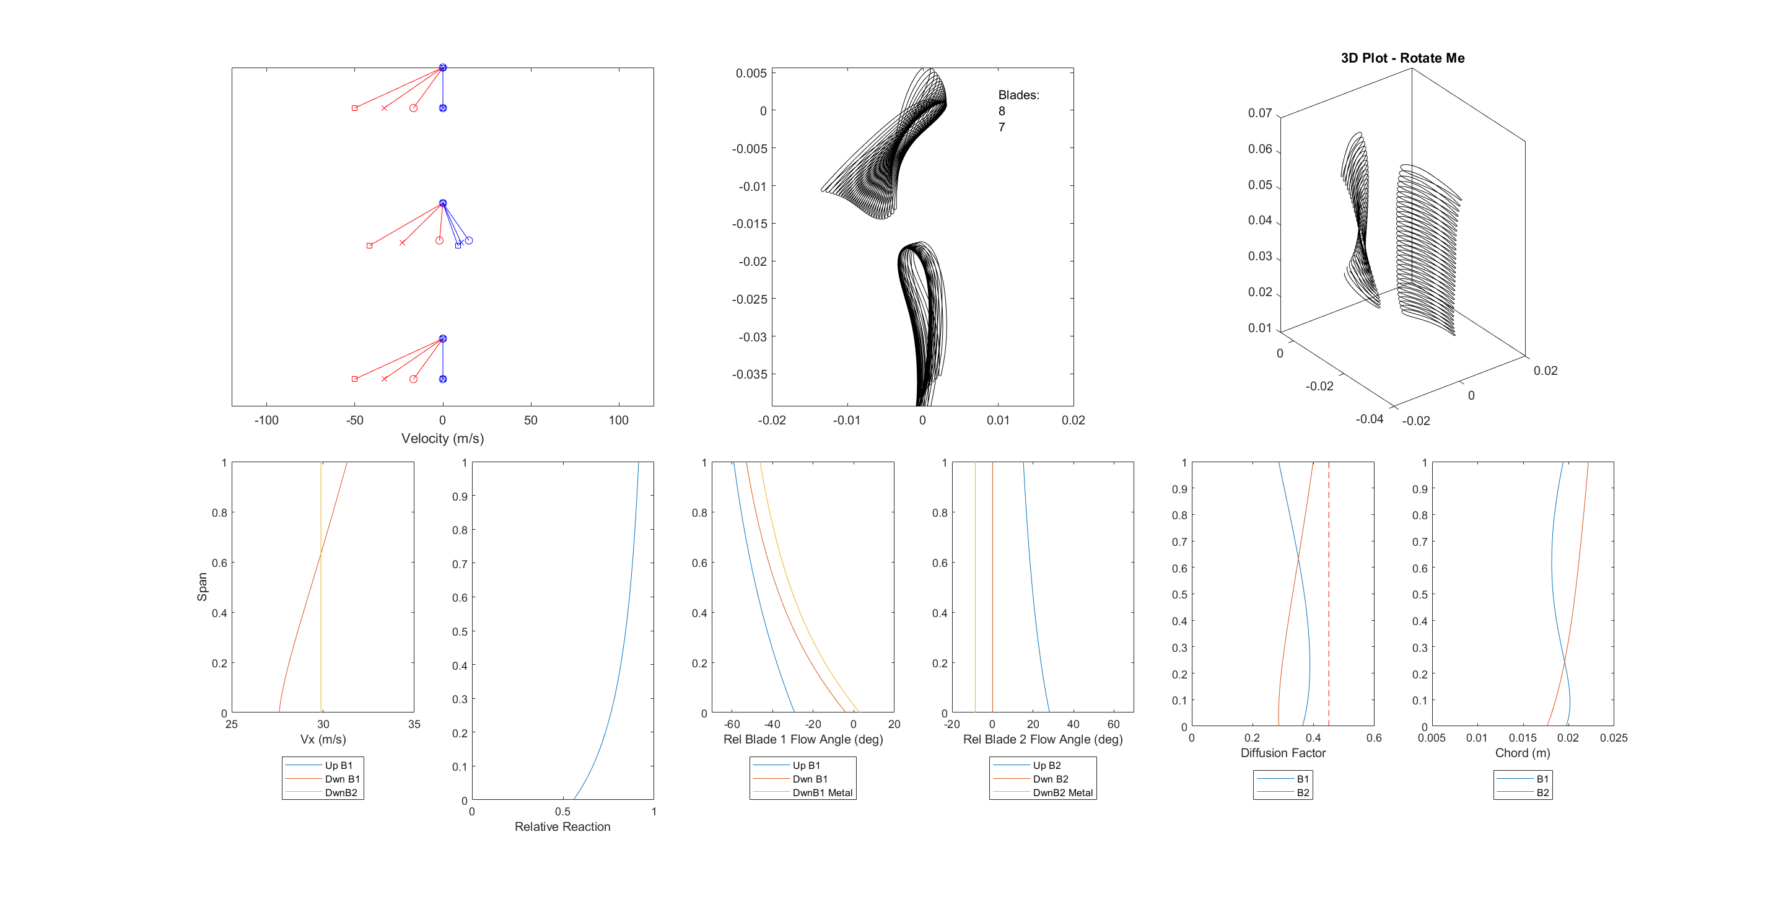
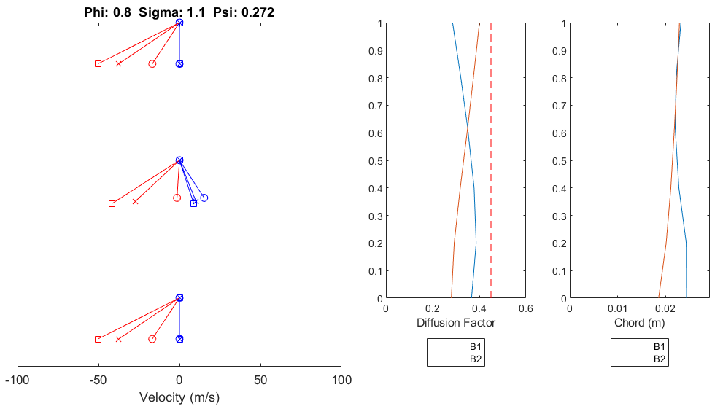

Design point comparison with V1
V1
V2

Slide 9
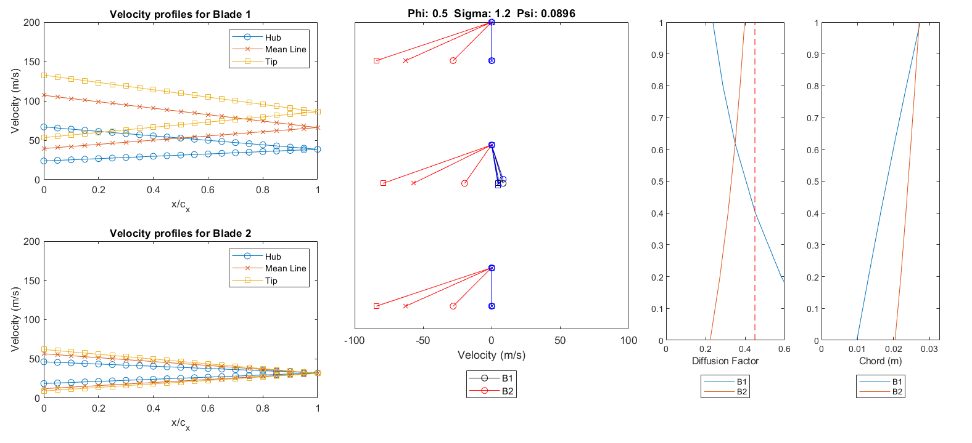
Away from original design point - NRF
Notes:
Phi=.5 Sigma=1.2, very large rpm, lower efficiency, large profile losses!
DF is large at root, just to set dev

Slide 10
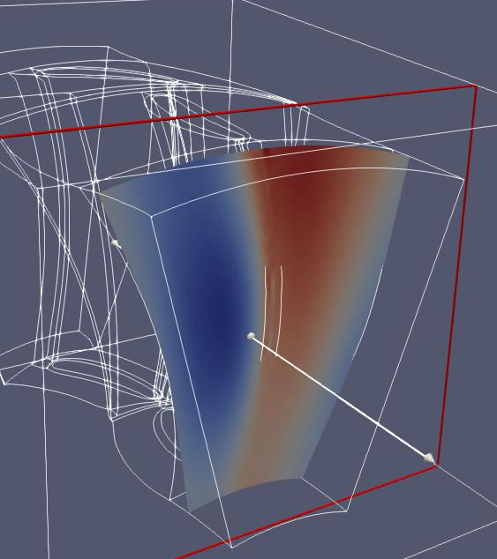
CFD
Aim Create Smith chart from CFD simulations across design space to compare with Loss Model
Create geometry
Generate mesh
Submit to Darwin (TS)
Postprocess
MATLAB
Autogrid
Paraview
Notes:
Compare
Absolute efficiency
Shape
Deviation

Slide 11
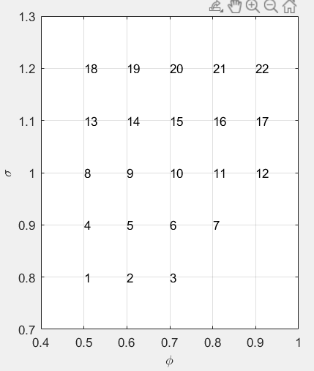
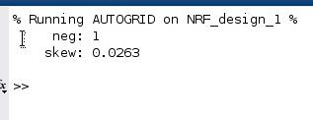
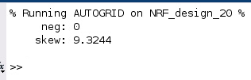
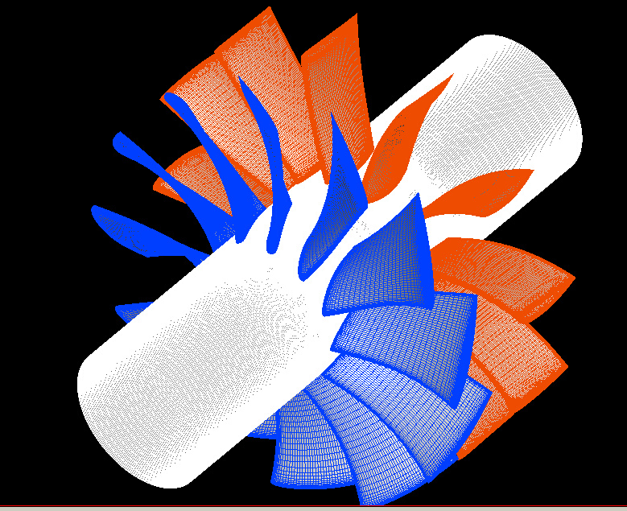
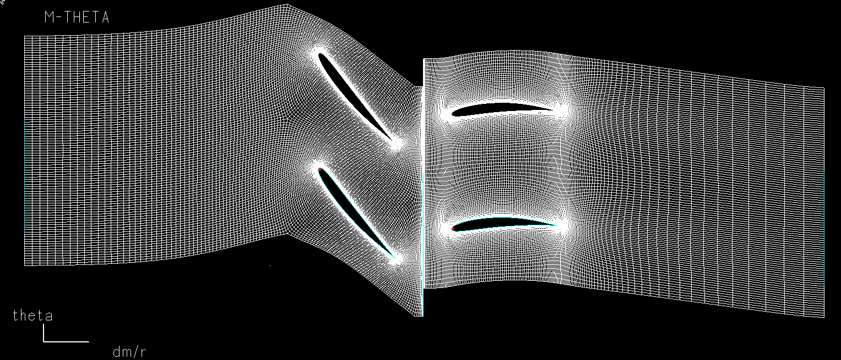
Meshing thus far…
Negative cells – issue!
Not an issue for des20
Note Nb >= 12
Notes:
Negative cells – sometimes bad geometry? Massive hub chord for dodgy designs – overlap? N=12 for low rcas an issue?

Slide 12
Optimiser
Aim Allow design space to be traversed to yield optimal designs for a given payload and number of propulsors
Test simple optimisation (phi,sig)
Assess optimiser using range of starting points
Allow increasing numbers of variables to be optimised

Slide 13
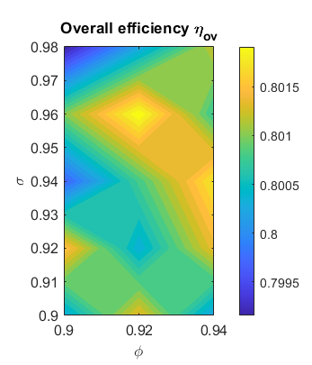
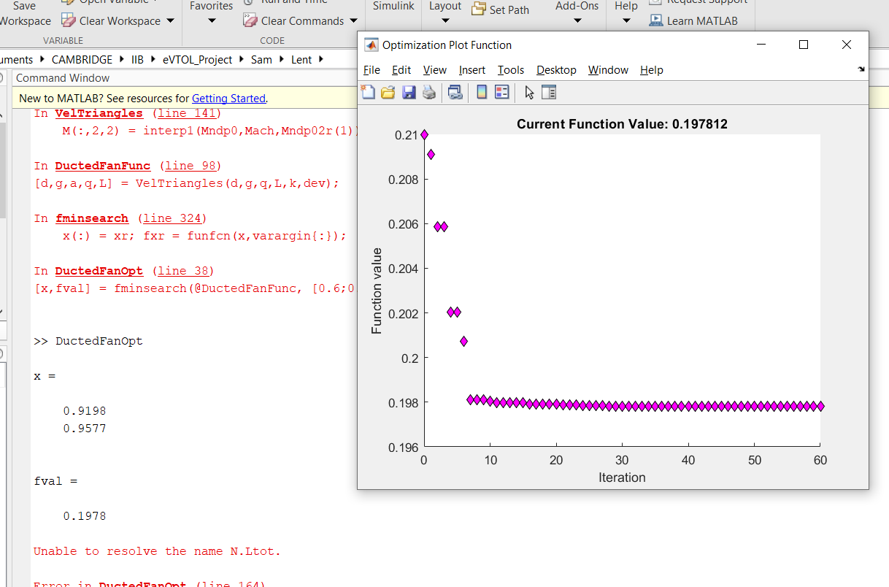
Optimiser testing - stage 1
Optimised design point:
Phi: 0.9198
Sigma: 0.9577
Efficiency: (1-0.1978) = 0.8022

Slide 14
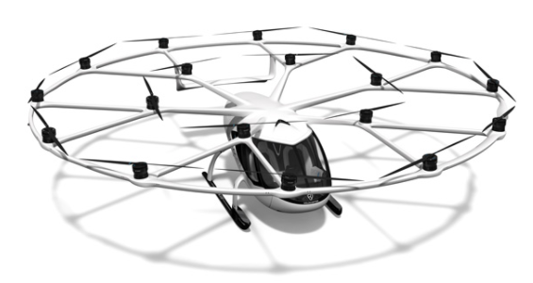
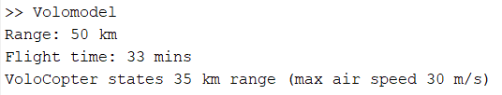
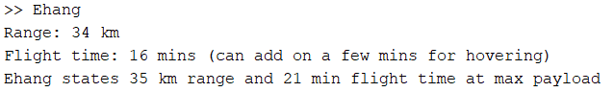
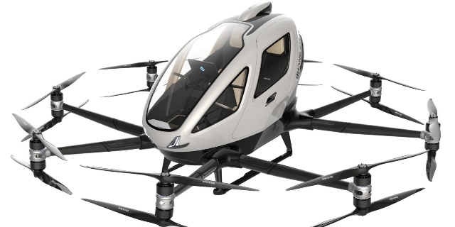
Guestimating
Aim Develop performance models for existing eVTOLs that corroborate the quoted specs, to then benchmark against ducted fans

Slide 18
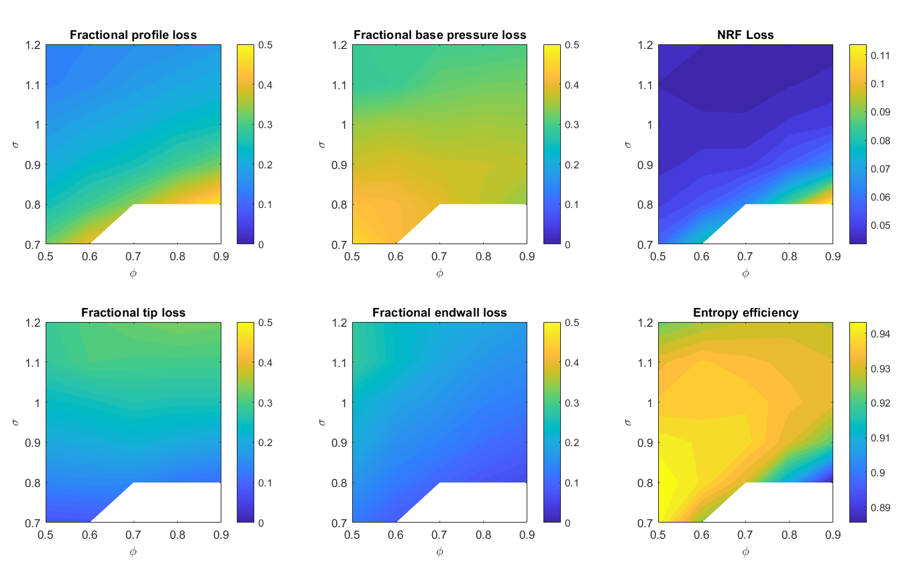
eVTOL 1D losses

Slide 19
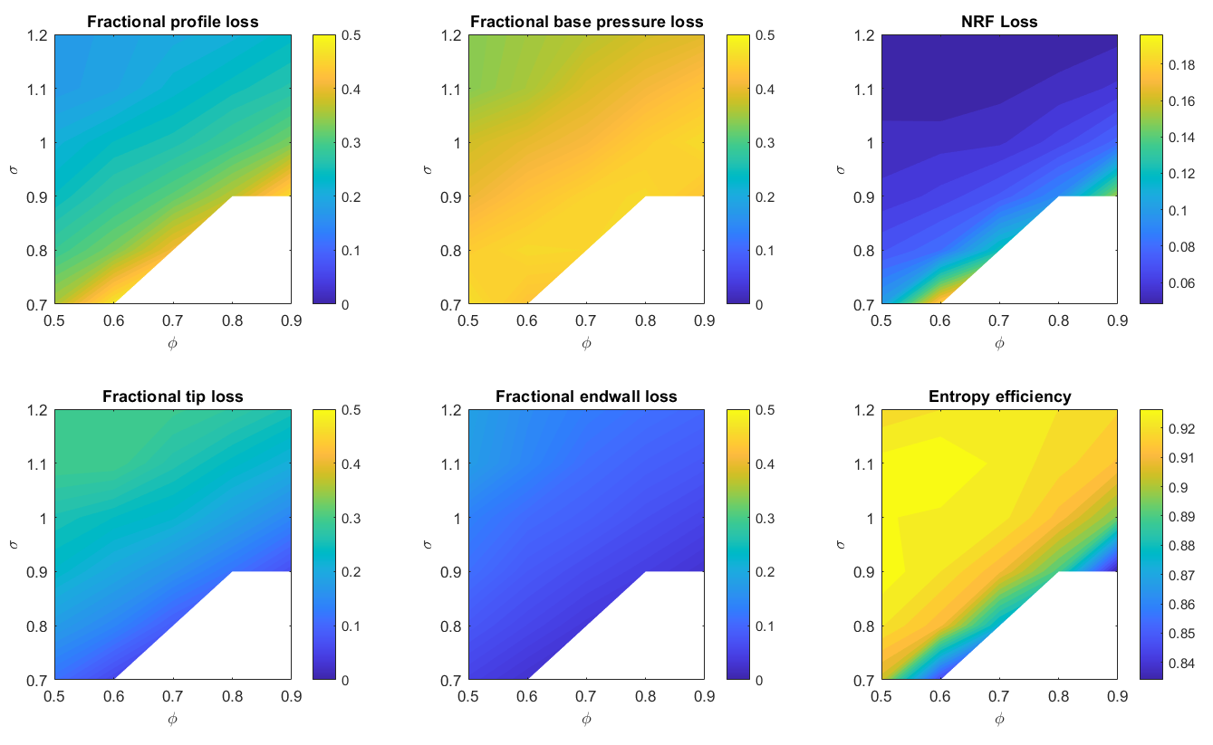
WRONG eVTOL 2D losses
Wrong indice used in ‘v down’ for base pressure calc

Slide 20
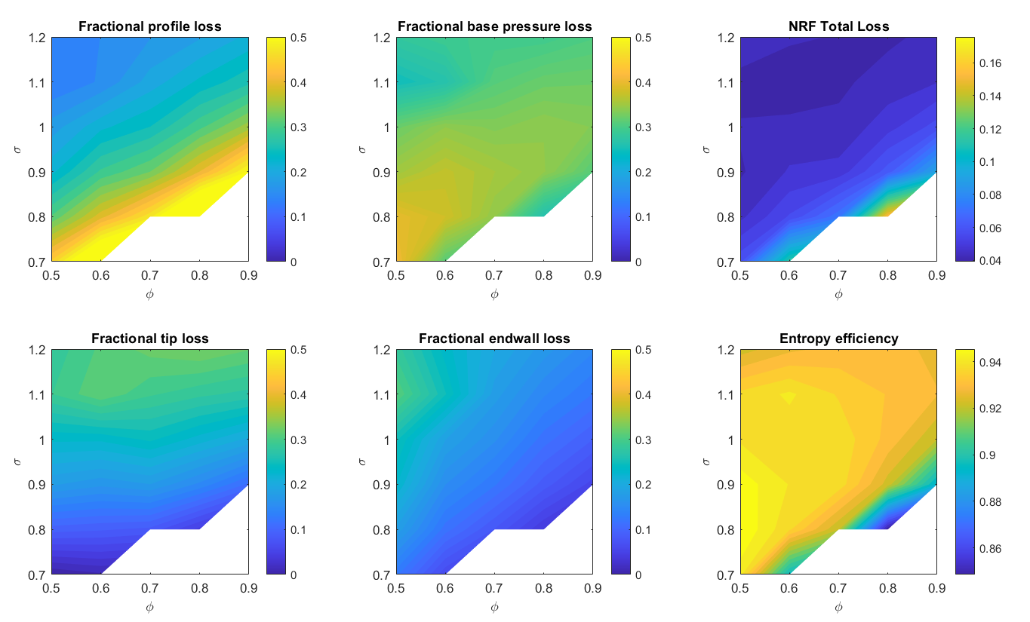
eVTOL 2D losses

Slide 21
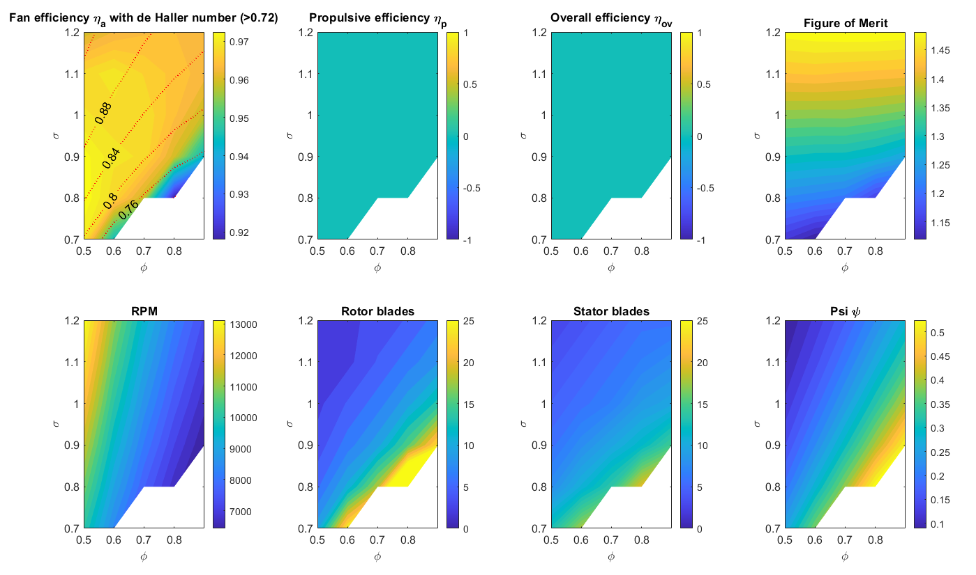
2D Whittle

Slide 22
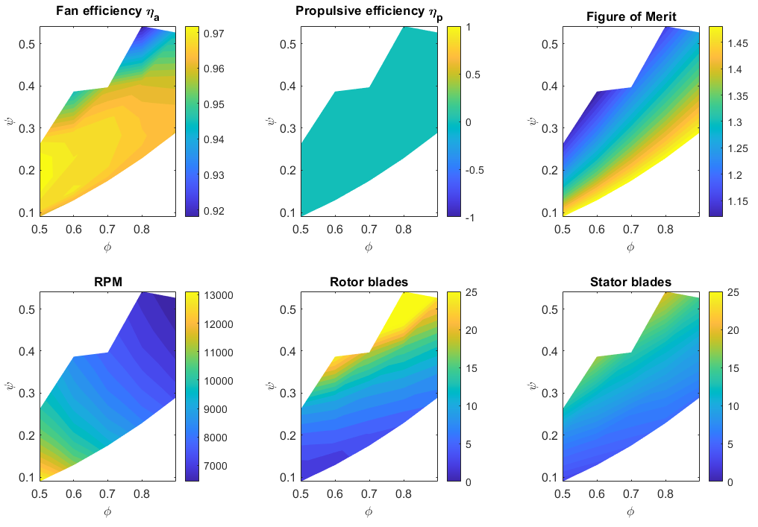
2D Whittle eVTOL

Slide 23
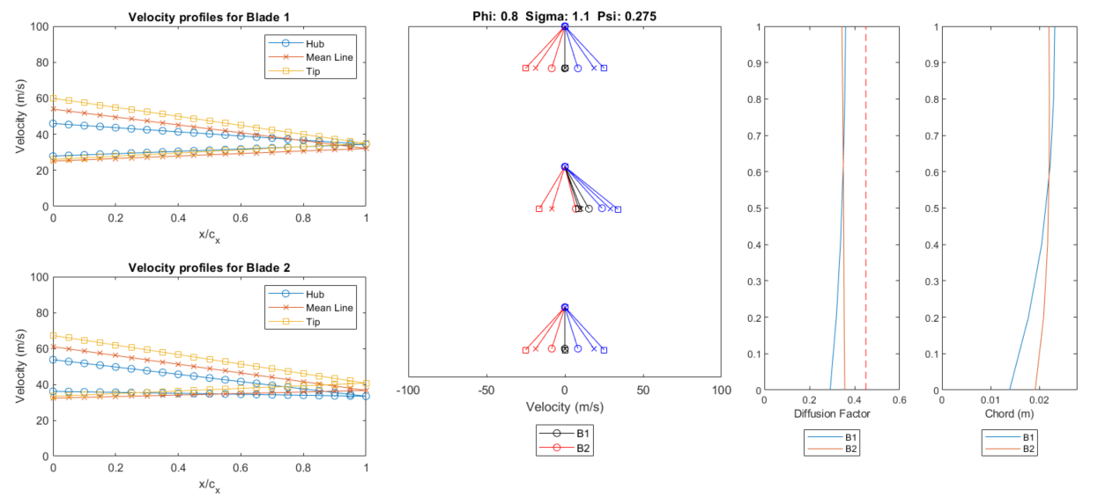
Design point CRF

Slide 24
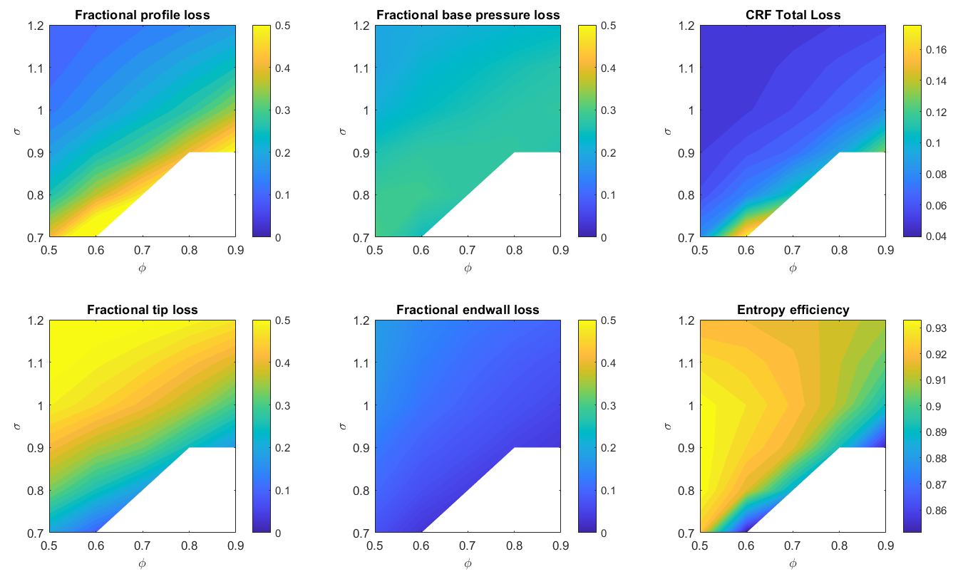
CRF

Slide 25
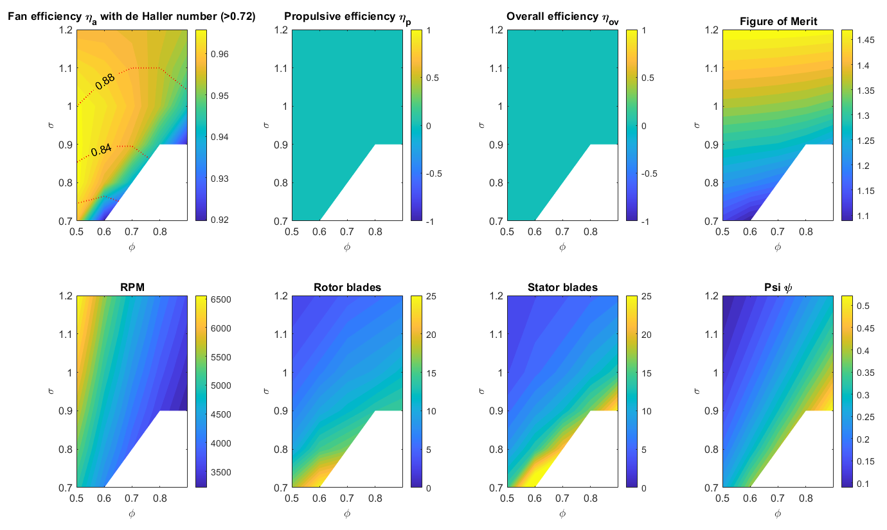
CRF

Slide 26
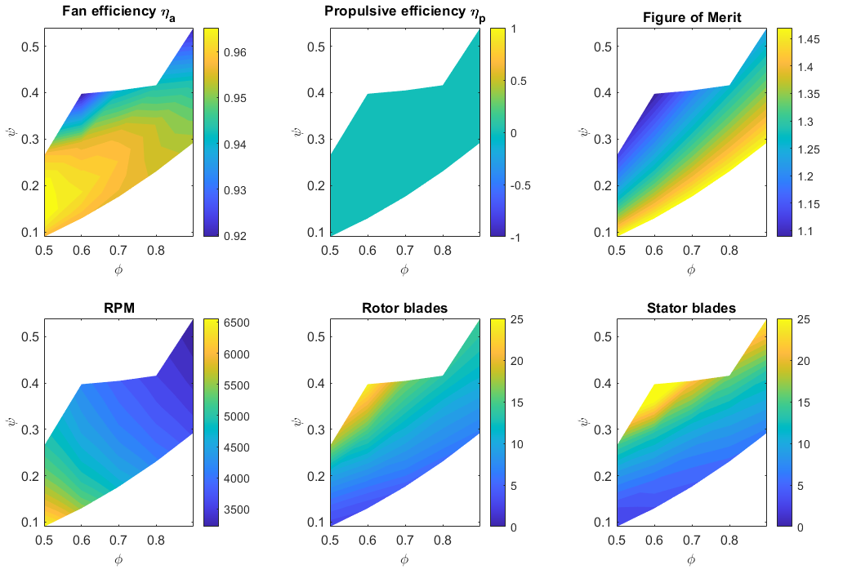
CRF

Slide 27
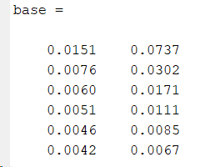
eVTOL 2D losses

Slide 28
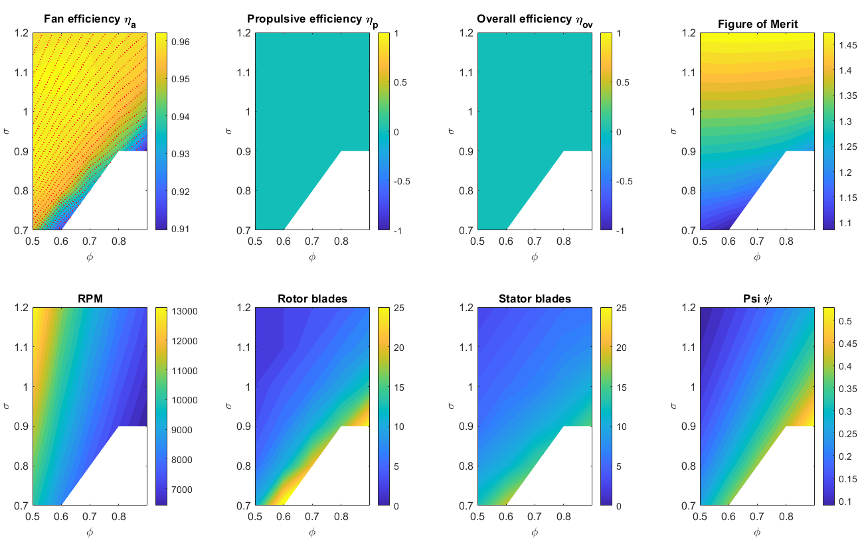
eVTOL phi sig

Slide 29
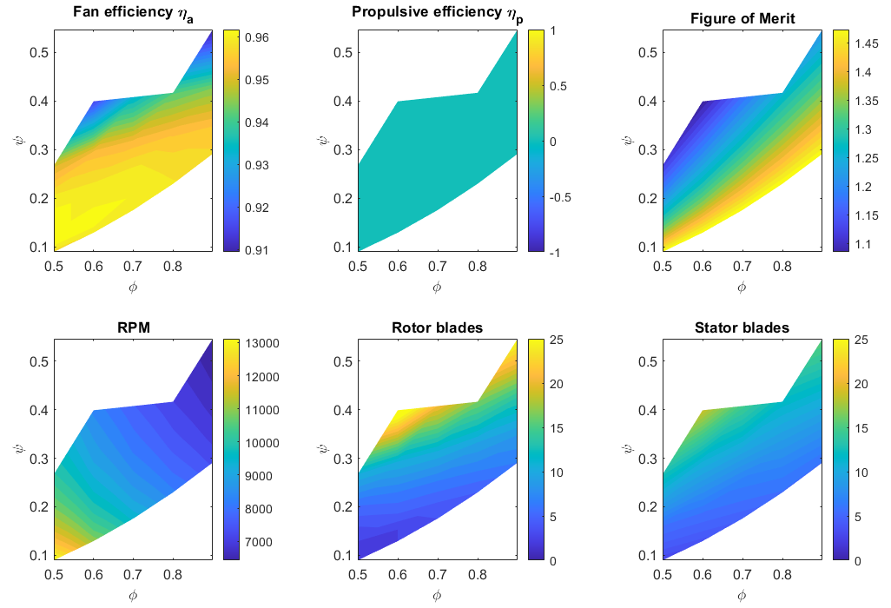
eVTOL phi psi

Slide 30
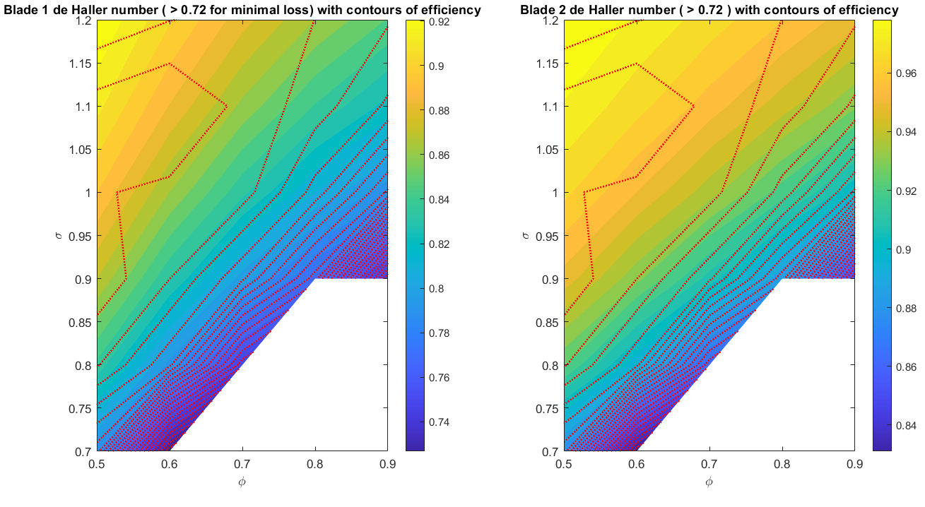
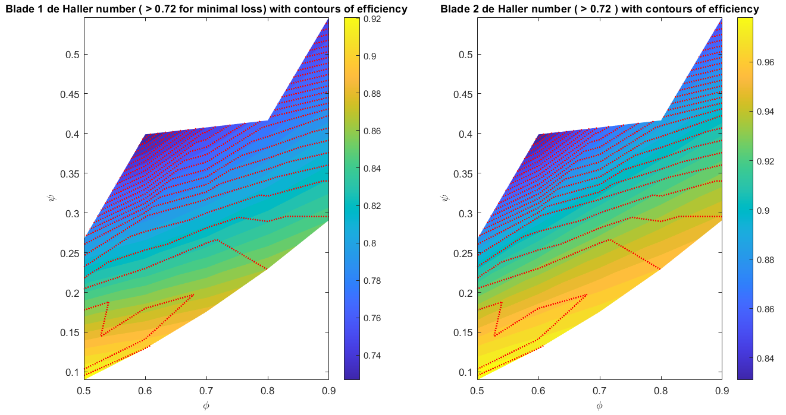
eVTOL dH

Slide 31
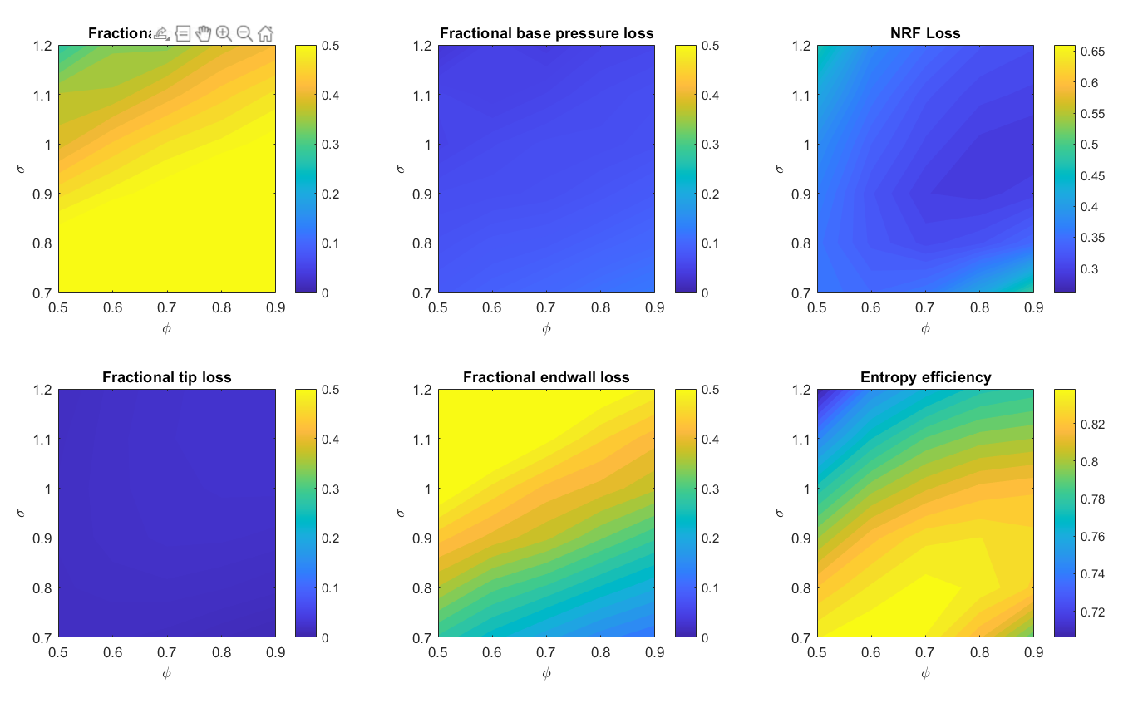
BB – 2D losses

Slide 32
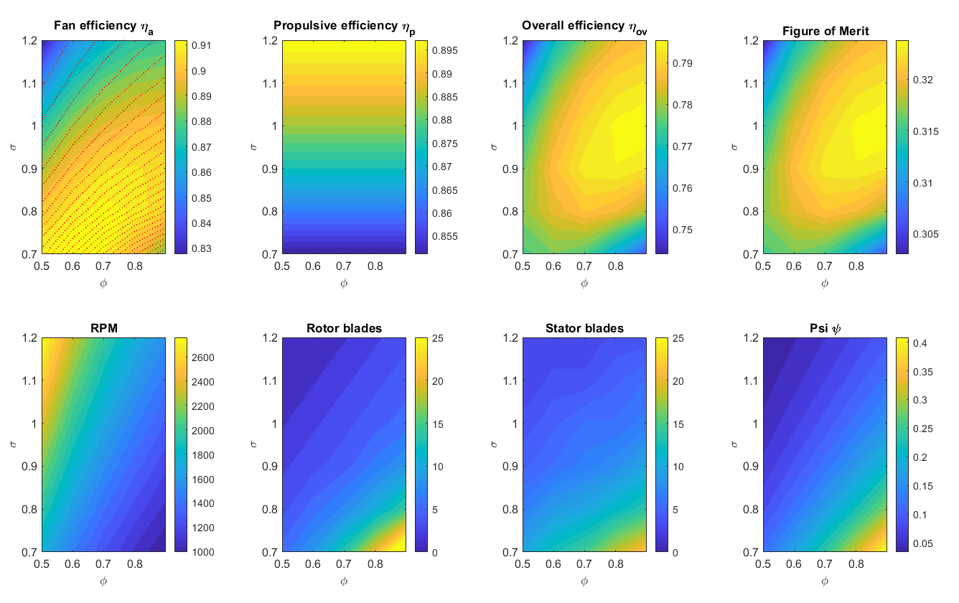
BB phi sig

Slide 33
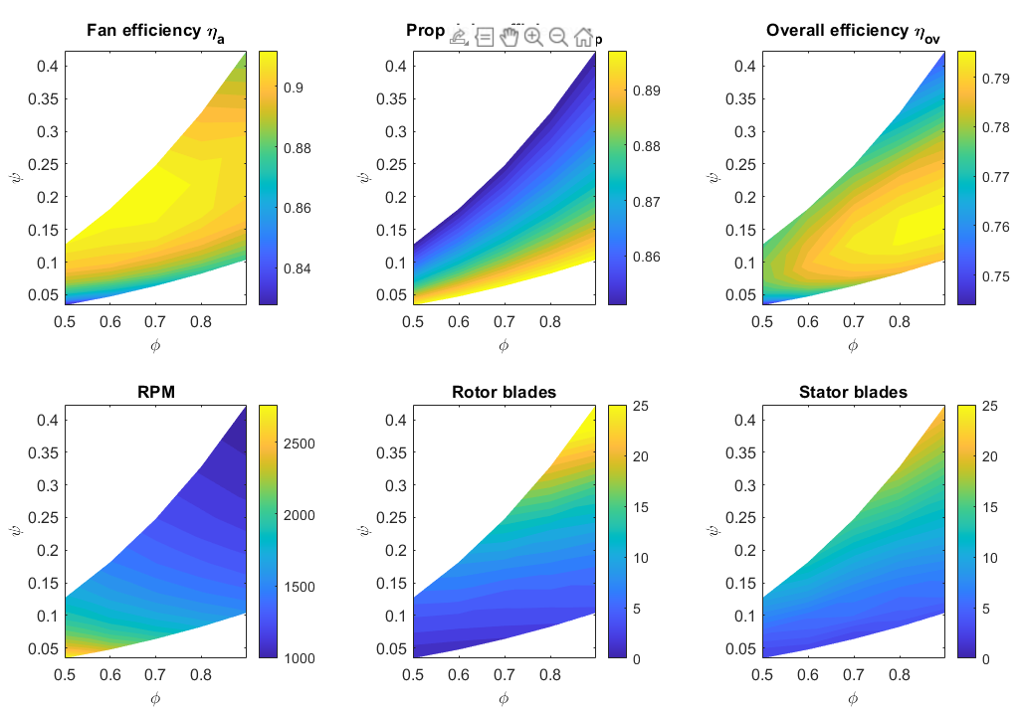
BB phi psi

Slide 34
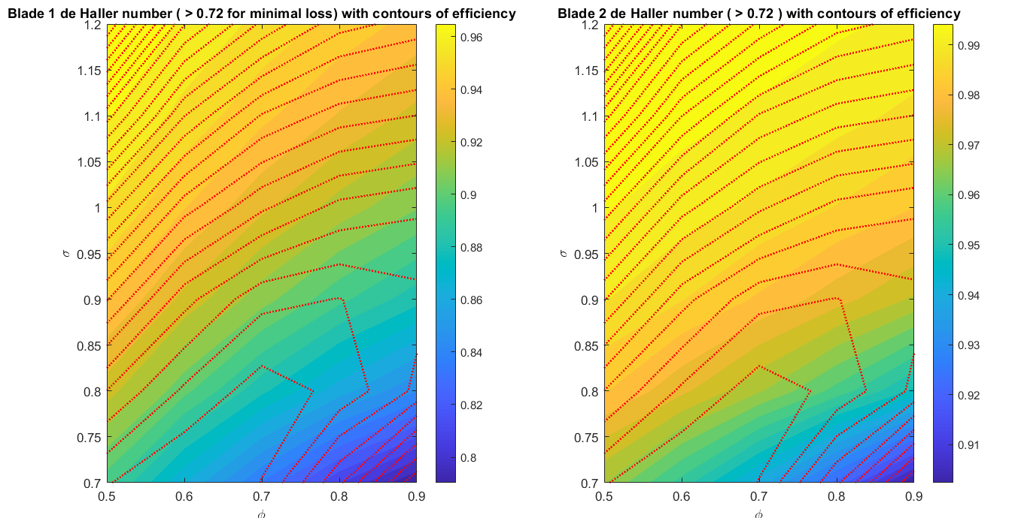
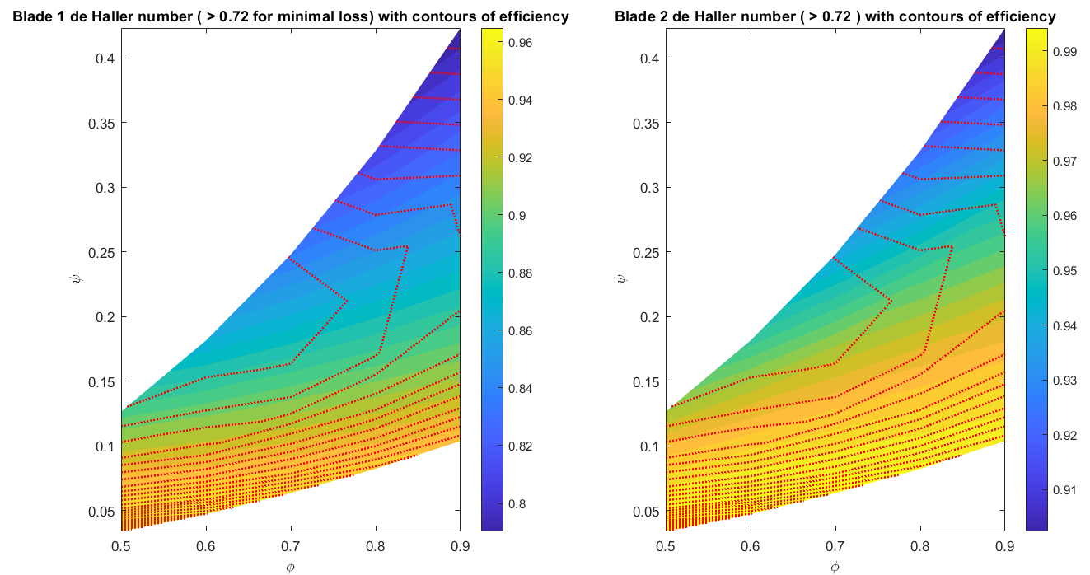
BB dH

Slide 35
V2 Progress
Convergence time reduced to ~0.2s per design (1D)
Error handling implemented to highlight and skip over problematic cases
Contra-rotating added
Radial equilibrium implemented for a mixed vortex design
General restructuring and tidy-up
Notes:
Mention spanwise variations of T, P, rho (stag stat) not implemented – necessary? Negligible difference in our operating regime
Mean line is an indice

Slide 36
Assessing Model
Simple checks
Turn off lossy mechanisms (gaps, thicknesses = 0) – efficiency should be unity (isentropic)
Check values at design point (phi=0.8, sigma=1.1) compared to V1 output
Error handling
CFD
Notes:
Check not any abnormal errors (NaNs in random segments)

Slide 37
Comments
Calculated losses are sensitive to associated loss coefficient
Endwall losses need further exploration

Slide 38
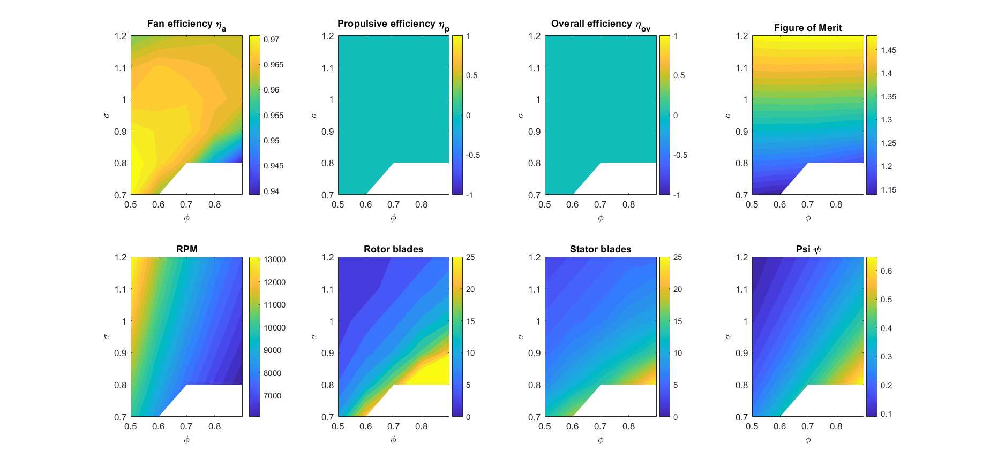
NRF Phi vs Sigma
Geometry:
D_casing = 0.12 m
D_hub = 0.04 m
Notes:
Fan eff – contrast with FOM, tradeoff
Rotor + stator blades lead to large values – s/c closer to zero
Picked up by error handling and eliminates datapoints

Slide 39
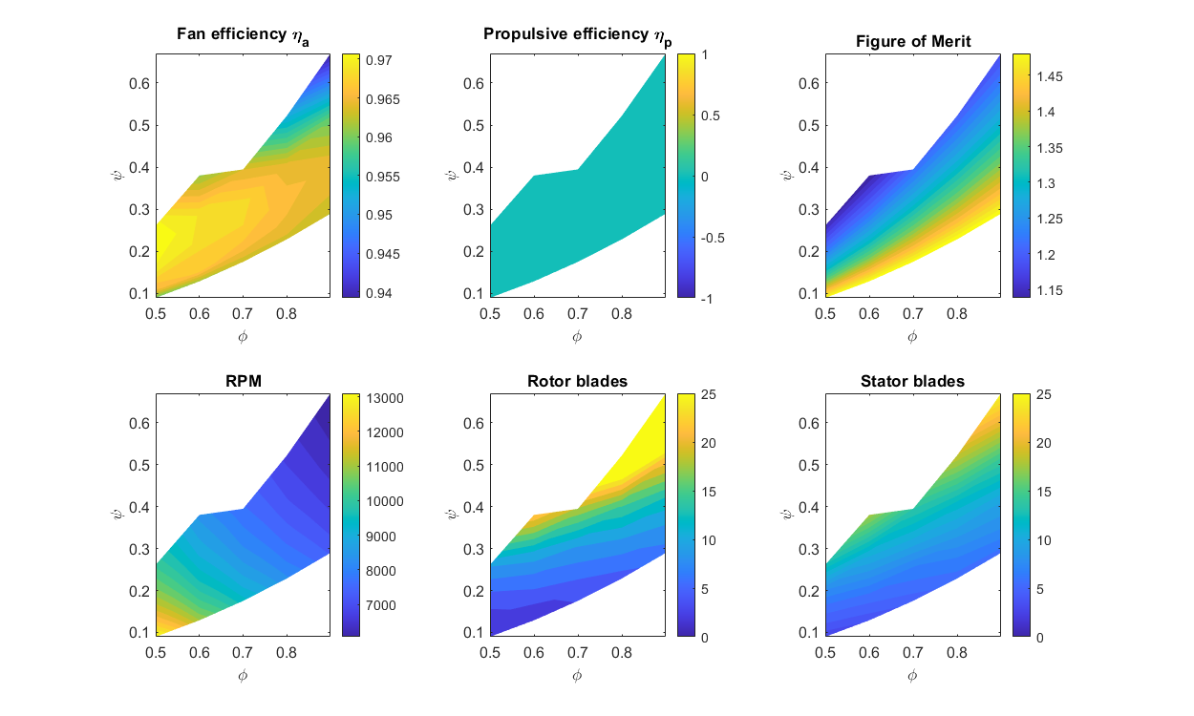
NRF Phi vs Psi
Low s/c gives high blade conut
Notes:
For a given flow coefficient, a greater stage loading requires more blades, until the model collapses – geometry unsuitable in those conditions
Thankfully, design point low psi, around 0.25

Slide 40
NRF Mean Line Losses
Losses only evaluated at mean line
Notes:
Expected increase in profile loss as blade count increases
Difference between loss and 1-efficiency

Slide 41
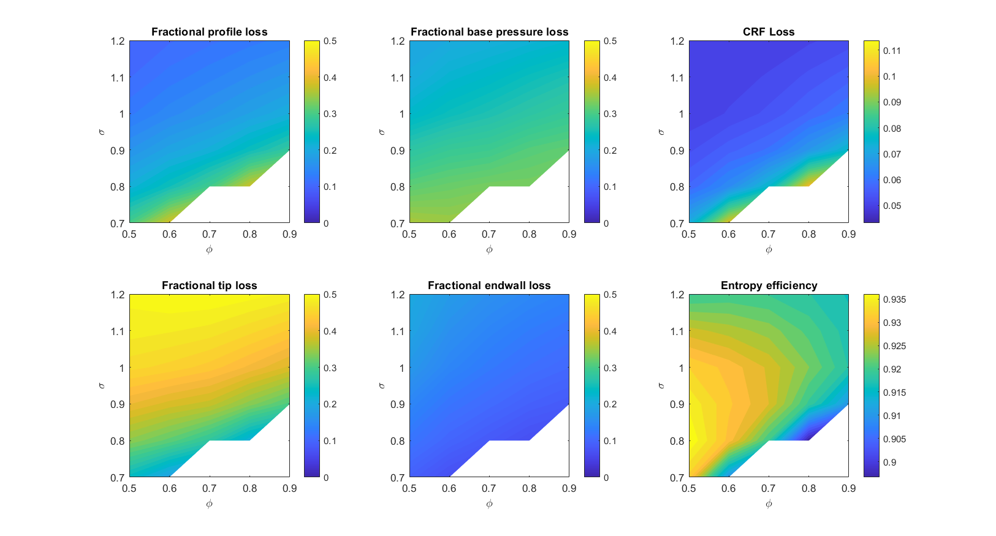
NRF vs CRF Losses
NRF
Adding a second rotor increases loss
CRF
Tip losses dominate CRF loss except at extremities
Notes:
Adding a rotor, blade speed halved. Previously stator had no gap
Mild increase in loss going to CRF, clearly the tip loss makes up a great proportion of the loss
End walls least contributing – expect this to increase with adding ducts/casing surrounds

Slide 42
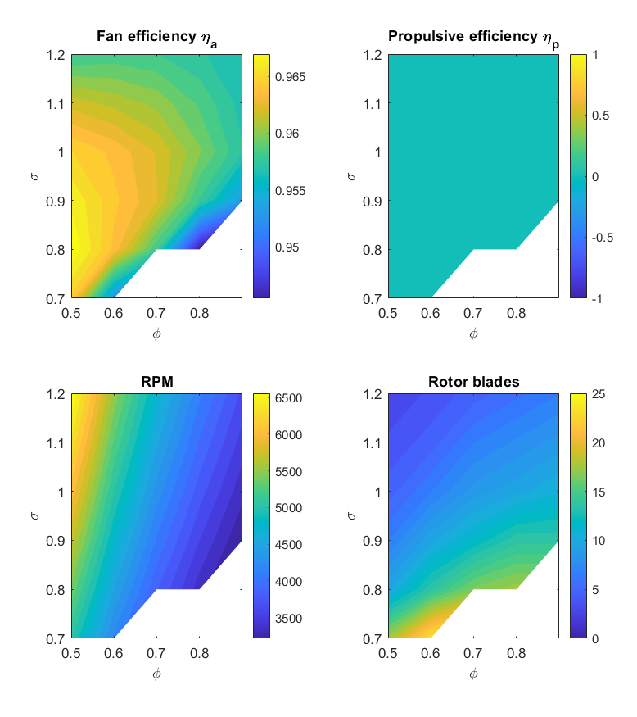
NRF vs CRF
NRF
CRF
Notes:
Decreased fan efficiency – cf tip losses
Halved blade speed
Design space is larger for blade numbers ~5-10, used in lab

Slide 43
CRF Losses

Slide 44
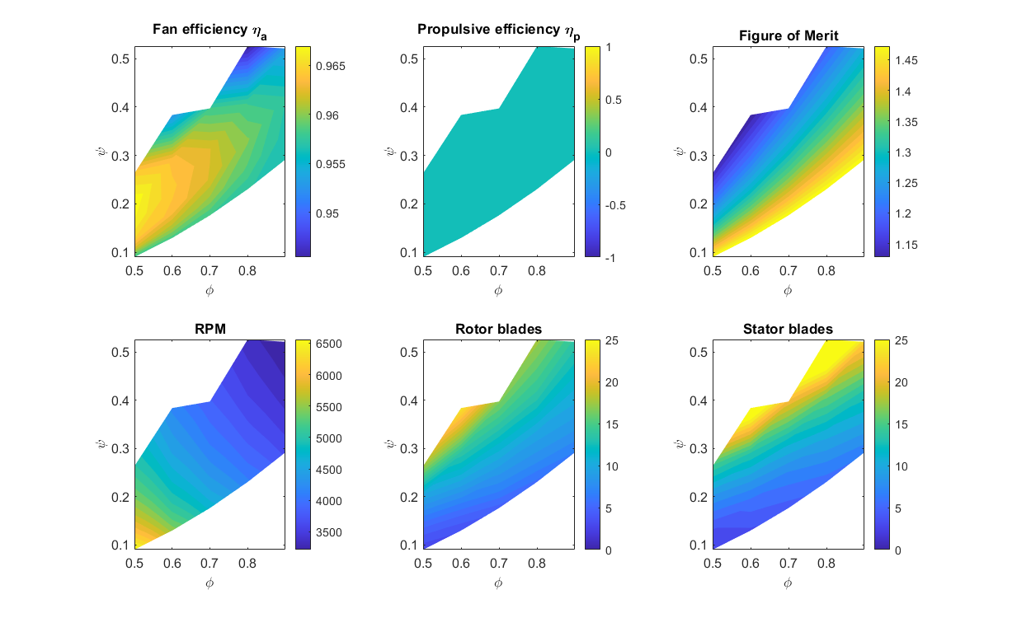
CRF 3

Slide 45
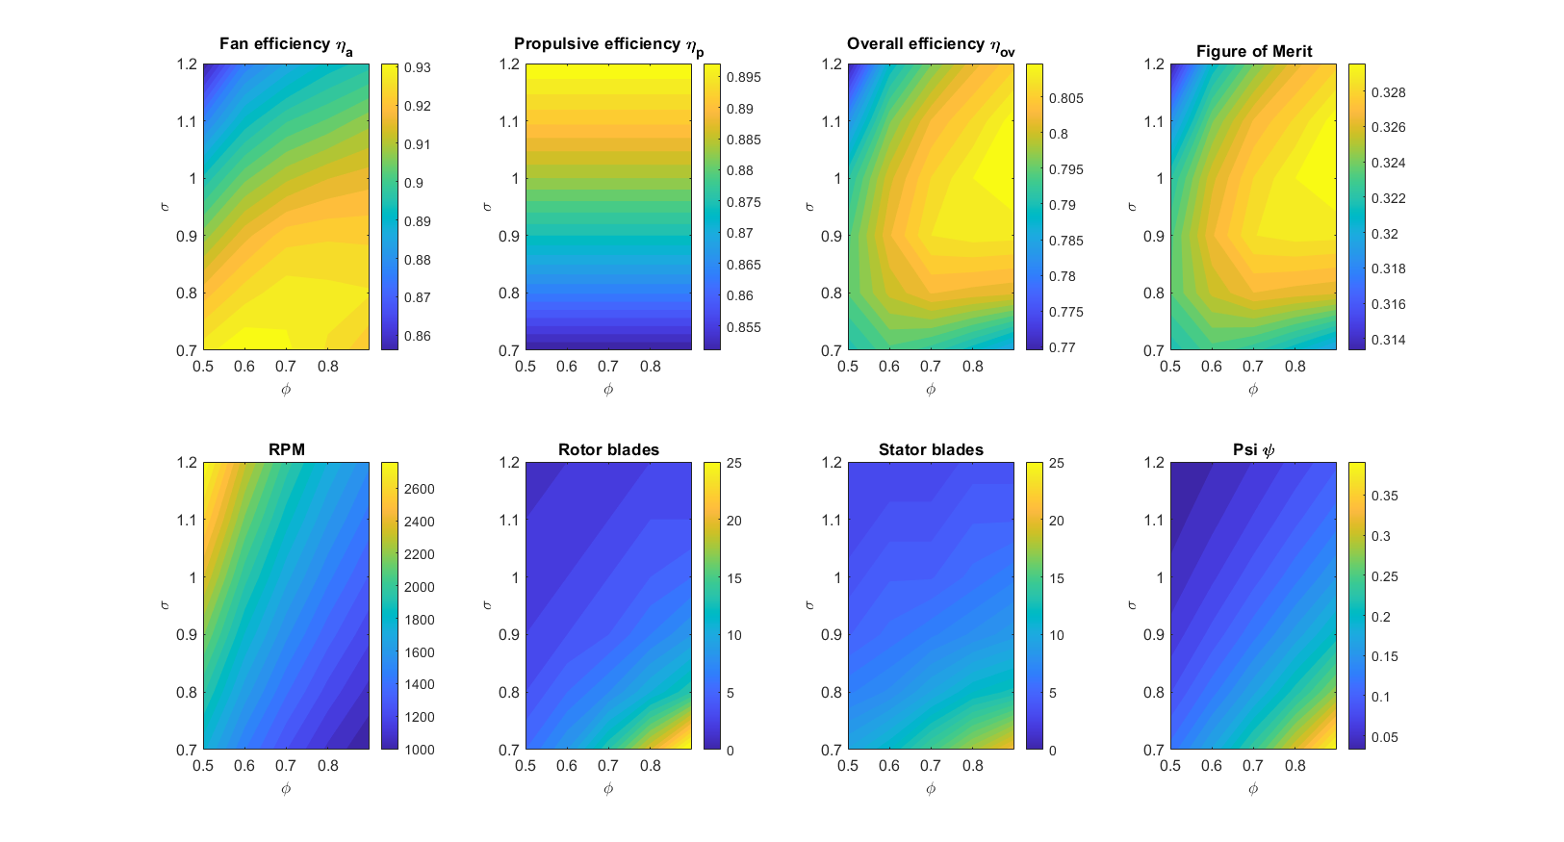
Blue Bear NRF Performance Characteristics
Geometry:
D_casing = 1.4 m
D_hub = 0.42 m

Slide 46
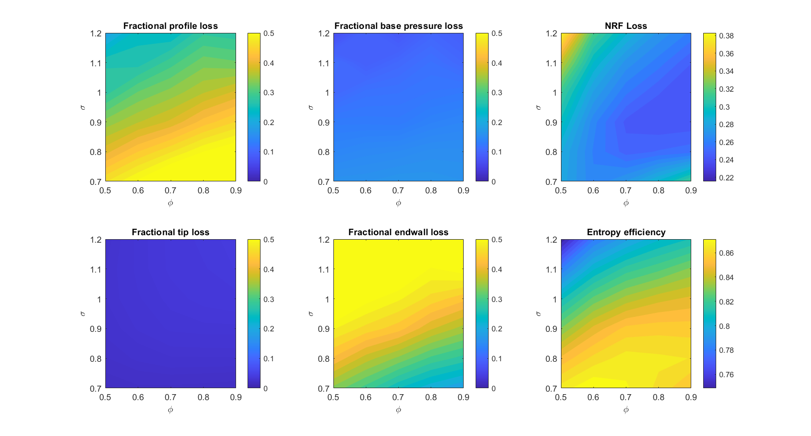
Blue Bear NRF - Losses
Geometry:
D_casing = 1.4 m
D_hub = 0.42 m
Notes:
Geometry!!

Slide 47
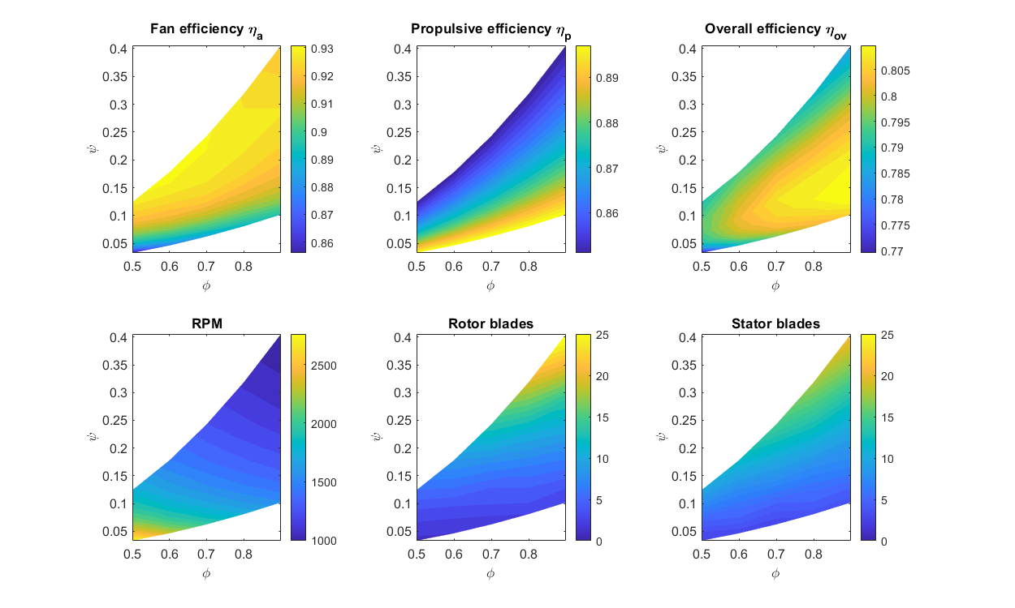
BBNRF3

Slide 48

BBCRF1

Slide 49

Blue Bear vs Whittle eVTOL – CRF Losses
Whittle eVTOL
Geometry has a big effect on loss origins
Notes:
Just for interest

Slide 50

BBCRF3

Slide 51
Next steps
Incorporate spanwise variations into the loss model (integrating up the blades instead of at mean line)
Develop endwall loss calculations
Non-isentropic inlet/exit ducts?
Allow capability for inlet/exit swirl
Incorporate a motor efficiency

Slide 53


Vortex Exponent
SDG: 1 = free, -1 = forced

Slide 54
Next Steps
Plot characteristic of fan using thrust plate at exit to vary flow coefficient
Confirm new motor compatibility (tweak if need be) then print
Assemble flying rig and recalculate system efficiency
Attempt hover with 4x EDF

Slide 55


Printed Design
Notes:
Changes since last iteration
Thicker stators to accommodate wire (marginally)
Chord increased to utilise space and minimise rotor-stator distance

Slide 56
Design Performance
Notes:
Larger chord, maximise space
Large rotor sweep at hub (geometric constraints)

Slide 57
Concerns
Synchronous vibration of rotor
Outsource stator prints, machine rotors from plastic block
Axial movement in motor
Increase validity of results through using same motor
Effect of blade count unknown
Iterate various designs through CFD prior to outsourcing / machining?
Outside flying challenges
(enter solution here)
Notes:
(and general printing issues)
Outside flying
Interfacing to do remote hover
RPi records loadcell (don’t need) and RPM (need)
Allow drone to traverse
ALSO! Broken lug ☹

Slide 58
Week 5 Plans
(Test existing design?)
Vary inlet/outlet to assess any performance change
Low HTR design at low Re (JSE demonstrated off-design results)
Continue investigating literature
Cement premise of project
Notes:
JSE – high psi, lower phi, hence much lower sigma

Slide 59



MATLAB Design using SDG Code
Inputs
Outputs
Flow coefficient | $$φ$$ | 0.80
Casing radius | $$r_{c}$$ | 60 mm
R_Lean | ° | 20
R_Sweep | ° | 4
Area ratio | $$σ$$ | 1.1
Thrust | T | 10 N
Stage loading (tt) | $$ψ$$ | 0.265
Fan speed | $$Ω$$ | 7977 RPM
Blades [R,S] |  | [11,10]
Notes:
High thrust, but reducing this brings fan speed down eg 6N gives 6200 rpm
Also sensitive to area ratio: sigma of 1 gives 7600 rpm

Slide 60

Performance Overview
Notes:
Notable points:
Sensible triangles/shape
Constant deviation, to ensure correlation at large HTR’s doesn’t blow up (this can be changed to give constant DF, but not much shape difference)
Little chord variation
Very 2D stator

Slide 61

Adding Sweep and Lean
Sweep
Parabolic, quadratic
4°
Lean
Parabolic, quartic
20°
U
Suitable values chosen from Taylor & Miller (2015)
Radial view from annulus
Notes:
Sweep – side-on
Lean – front-on

Slide 62

Finalised Rotor
Notes:
Lots of altering .ibl file to ensure CAD fit

Slide 63
MATLAB to .stl for 3D Printer
Matlab
Press run
Output .ibl for rotor and stator
Creo
Change curves to new .ibl file
Regenerate
OPTIONAL: Save .ibl files under separate name
Reselect curves
Save as .stl

Slide 64
Week 3 Plans
Tweak design if necessary
Print 4x rotors
Check whether stators, shrouds etc also need printing
Continue exploring literature

Slide 65




The Take-Off of e-VTOL
Ducted Fans
Higher thrust
Less Noise
Contained (Safer)
Do they work at a SYSTEM level?
BUT
Notes:
The e-VTOL market has exploded in the past few years and is projected to continue growing, trebling by 2024.
The market shows us that no one configuration is being sought after, with a vast array of designs put forward
PRIMARILY
PROPELLERS
DUCTED FANS
Ina static test, a ducted fan has a higher thrust output, is less noisy and is contained, meaning it is safer.
However does the cost of weight and stability prevent them from being a better propulsion system?
How we can determine whether ducted fans are a viable system solution to the e-VTOL propulsion problem>

Slide 66
Project Questions
Are ducted fans more efficient in static hover?
Are ducted fans dynamically stable in an e-VTOL application?
Notes:
This problem has two primary facets, arising from
A static analysis
A dynamic analysis
Firstly, the ducted fan as a system must be more efficient than a standard propeller in a static hovering configuration. Does the reduction in power requirement outweigh the increase in weight of the vehicle? Hence, ‘Are they a more efficient SYSTEM for e-VTOL vehicles?’
Secondly, the dynamic feasibility of the ducted fan is to be considered. How does the performance vary when the vehicle is subjected to lateral manoeuvres? Hence, ‘Are ducted fans FEASIBLE for an e-VTOL APPLICATION?’

Slide 67
Are ducted fans more efficient in static hover?
Does added efficiency outweigh weight penalty for a simple light-weight design?
Hover tests with variable payload
Quadcopter propulsors compared:
Generic off-the-shelf propeller
APC e-VTOL optimised propeller
Ducted Fan (??)
Notes:
Changing a propulsor from a propeller to a ducted fan introduces a significant increase in weight.
The design must therefore be weight minimized, however, does the increase in performance outweigh the extra weight required?
Tests will be conducted with various payloads to determine performance across the fan characteristic.
Need to design a ducted fan suitable for this test.

Slide 68







A Superior Figure of Merit
$$M_{F}=\frac{T_{T}}{P}\sqrt{\frac{T_{T}}{2ρA}}$$
$$A$$
$$A$$
$$A_{E}$$
$$M_{F}=1$$
$$M_{F}=\sqrt{2σ}$$
$$σ=\frac{A_{E}}{A}$$
Notes:
Need to quantify performance, SOMETHING TO MAXIMISE
Figure of Merit is a non-dimensional thrust to power ratio for a propulsor with zero freestream velocity, ie HOVER.
An ideal ducted fan can be shown to have a larger figure of merit than an open-rotor propeller, but this comes at the price of weight.
The diagram shows that an ideal propeller has a maximum FoM of 1. This is an absolute limit.
However, the ducted fan has another degree of freedom, the exit area of the diffuser can be varied and set (shown here as A_E). This control over flow area results in a FoM that has a dependence on the diffusion factor (SIGMA, defined here by A_E/A). This means an ideal ducted fan with a 1:1 diffuser has a FoM of 1.4, even without any diffusion.
Hence, how can the ducted fan be designed to maximise FoM in a system with a diffusion factor limited by both length and weight?
EXTRA
PROPELLER MODEL
Velocity actuator
Exit area NOT EQUAL to prop area (ie SMALL but non-unity FPR)
EXIT pressure equal to atmospheric
Consider ENERGY and MOMENTUM to get expression for area ratio

Slide 69









Reduction of Free Variables
Floating Variables
$$Φ, ψ$$
Fixed Variables
$$r_{h}, r_{c}, σ, Ω (\sim \frac{1}{2}{VOLTAGE}_{MAX})$$
$$Ω$$
$$T_{P}$$
$$σ^{2}=\frac{φ^{2}}{2ψ}$$
$$W_{P}$$
$$r_{h}$$
$$r_{c}$$
$$A_{E}$$
Notes:
The ducted fan has a broad design space that can be characterized by two variables, flow coefficient and stage loading (PHI and PSI)
The remaining variables have been fixed, either inherently by definition (sigma phi psi)
OR by geometric constraints (r_h)
OR by electrical limits (OMEGA)
However, there is no direct limit on the casing radius?
To close the problem, the thrust produced must be equal to the vehicle weight. I developed a mass model to relate both these quantities to the casing radius, and solving this problem at each design point, obtained the critical operating point for each.

Slide 70





Reduction of Free Variables
Floating Variables
$$Φ, ψ$$
Fixed Variables
$$r_{h}, r_{c}, σ, Ω (\sim \frac{1}{2}{VOLTAGE}_{MAX})$$
$$Ω$$
$r_{h}=$Motor Radius
$$Ω_{max}=k_{v}V_{supply}$$
$$∴Ω_{OP}=k_{v}\frac{V_{supply}}{2}$$
$$T_{P}$$
$$W_{P}$$
$$r_{h}$$
$$r_{c}$$
Notes:
The ducted fan design has a broad design space that can be characterized by two variables, flow coefficient and stage loading (PHI and PSI)
The remaining variables have been fixed, either inherently by definition (sigma phi psi)
OR by geometric constraints (r_h)
OR by electrical limits (OMEGA)
However, there is no direct limit on the casing radius?
To close the problem, the thrust produced must be equal to the vehicle weight. I developed a mass model to relate both these quantities to the casing radius, and solving this problem at each design point, obtained the critical operating point for each.

Slide 71





Reduction of Free Variables
Floating Variables
$$Φ, ψ$$
Fixed Variables
$$r_{h}, r_{c}, σ, Ω (\sim \frac{1}{2}{VOLTAGE}_{MAX})$$
$$Ω$$
$$T_{P}$$
$$W_{P}(r_{c})=T_{P}(r_{c})$$
$$r_{c}= ???$$
$$W_{P}$$
$$r_{h}$$
$$r_{c}$$
Notes:
The ducted fan design has a broad design space that can be characterized by two variables, flow coefficient and stage loading (PHI and PSI)
The remaining variables have been fixed, either inherently by definition (sigma phi psi)
OR by geometric constraints (r_h)
OR by electrical limits (OMEGA)
However, there is no direct limit on the casing radius?
To close the problem, the thrust produced must be equal to the vehicle weight.
I developed a mass model to relate both these quantities to the casing radius. Solving this problem at each design point obtains the critical operating r_c for design.

Slide 72


Maximise Figure of Merit, Minimise Power
Increasing $M_{F}$
Notes:
I developed this model to maximise FoM and Minimise power.
The diagram shows the power required at each design point.
There are limits shown.
The red line is a cuirrent limit for the motor
The Solid black line is the limit of diffusion factor =1
The dashed balck line is a geometric limit of diffusor symmetry.
This suggest we push the design towards the bottom left to reduce power.

Slide 73

Minimise Power… What a big fan you have
Notes:
This slide shows the variation in casing radius across the design space.
Previously, we determined the bottom left is the ideal design region however, this shows those designs to be too large.
Therefore I have chosen a design in the middle of this region

Slide 74




Chosen Design
Flow coefficient | $$φ$$ | 0.80
Stage loading | $$ψ$$ | 0.20
Casing radius | $$r_{c}$$ | 57.7 mm
Fan speed | $$Ω$$ | 7500 RPM
Diffusion factor | $$σ$$ | 1.26
Notes:
From my model, I have chosen this design.
A conservative diffuser and intake is used, that will be improved by the work Megan is going to talk about.

Slide 75



Preliminary Propeller Data – The Baseline
Power vs Thrust
Constant $M_{F}$ wrt $Re$
Notes:
The fan performnce will be compared against propeeller performance.
I have so far collected data for the propeller, shown here.
This shows teh propeller to have a constant FoM at various loads as expected. This FoM is fairly low as it is for an unoptimised propeller
I expect to see the hover optimized propeller closer to but still below 1, and the fan to be somewhere between 1 and 1.5
I will now talk about the dynamic aspect of the test.

Slide 76


Are ducted fans FEASIBLE in an e-VTOL application?
Does the intake duct reduce dynamic stability during manoeuvres?
Small horizontal manoeuvres of varying amplitude
Dynamic stability determined:
Does separation occur at intake?
Does control system remain stable?
$$M$$
Vehicle Velocity
Notes:
Now the fan has been developed, the next question is that of dynamic performance,?
The primary concern here is how the fan behaves in a crosswind, a common flow feature for a vehicle transitioning from hover to horizontal flight. (AS IN THE DIAGRAM)
Crosswinds can lead to separation and resulting decrease in performance AS WELL as destabilising moments on the vehicle.
THEREFORE the key questions are
Does separation occur?
Does the vehicle remain stable?
A test bed is needed to determine this

Slide 77

Modular Dynamic Test Bed
Work completed as part of UROP
Light-weight 3D printed parts (PLA)
Modular
Pixhawk4 flight hardware
Bespoke chassis
Additional Michaelmas work
RaspberryPi based on-board, real-time sensor hub
Sensor design, development and integration
Detachable Propulsor Assembly
(Ducted Fan or Prop)
Data Logging and Flight Control
Notes:
Here we see this test bed,
It has a cocentral data logging and flight control chassis,
as well as modular limbs and propulsor assemblies that are suitable for both ducted fans as well as propellers.
My design was 3D printed at the Whittle, allowing for rapid prototyping, also allowing the design to be as light as possible in my price-range (no carbon yet, sadly).
I have integrated flight control systems with a custom sensor management unit to provide on-board data logging and autonomous flight control.
This test bed allows all the required metrics to be determined…

Slide 78
Data Collection, Control and Conclusions
Figure of Merit
Power (Electrical, RPM, calibration)
Thrust
Flow separation at intake
Pressure Transducers
Control system stability
6-DoF inertial sensors
3 position sensors
Laptop
Pixhawk4 Flight Controller
Power Module (PM07)
RPi3 A+ Sensor Management
ONBOARD
ESC
ADC Breakout
RPM Sensors
Ultrasound Proximity Sensors
Pressure Transducers
Motor Assembly
Notes:
An overview of the system
Two main aspects to testing this way. The first is Control and the second is Data Collection.
This graphic shows the system level interactions involved.
Managing the vehicle as a whole is a laptop
The control aspect is handled by a Pixhawk4 Flight Controller that manages the stability of the platform.
Power and Motor control is shown on the LHS
The RHS shows the sensors and the RPi sensor hub.
I have developed a Raspberry Pi based sensor management unit that can record and transmit data. It includes up to 8-channel ADC that allows multi-stream data-logging remotely or on-board.
Sensors are integrated with the existing flight software to enable autonomous position control.
They allow both static and dynamic performance to be determined. These are shown on the left.
Figure of Merit is determined from Power and Thrust measurements
Flow separation comes from tappings and pressure transduces at the intake
Control stability can be determined from the flight control system
Using this test platform, I will be able to determine the performance of the fan in both a static AND dynamic context NExt term .
THANK YOU

Slide 79
Notes:
Back up slides
ESDU
LOW RE PROFILES FROM MATHEW M PAPER (DYSON)

Slide 80

Mass Model
Diffusor angle limited by flow separation
$$σ≤0.3313{\left(\frac{r_{c}−r_{h}}{L_{diffuser}}\right)}^{0.5275}$$
$$θ_{min}=\sin^{−1}{\frac{r_{c}−r_{h}}{L_{diffuser}}}=\sin^{−1}\left({\left(\frac{σ−1}{0.3313}\right)}^{\frac{1}{0.5275}}\right)$$
Notes:
When considering the mass model, a hidden fixed geometric variable, diffuser length, is set by the maximum angle of the diffuser from the axial flow direction.
The constants shown here are obtain from empirically obtained data in ESDU 75026 and represent a conservative limit on diffuser separation.
The equation shows that this limit can be expressed solely in terms of SIGMA (diffusion ratio) and hence the operating point variables PHI and PSI.

